Slide 1
Intelligent Prostheses
PRESENTED BY
MOHSIN MEHMOOD, Hafeez Shittu

Slide 2
Overview
Introduction
Biomechatronics and bilogical systems
Prosthetics
Human locomotion
Current prosthetics
Sensors
Intelligent control
System design and development
Specific requirements and development
Transfemoral and transtibial prostheses
System specifications
Future prosthetics
Conclusion

Slide 3
Introduction
Complexity of mechatronics
Parts, circuitry and computation
Human being, the mobile robot
Intelligent systems field

Slide 4
Biomechatronics and biological systems
Nature inspires technique
New discoveries in bionics
Examples: prosthetic limbs, eyes and hearing devices
Body: made up of trillion parts, cells
Nervous system, the key to complete understanding
Analyzes input
2. Sends output of contraction
3. Billions of neurons in brain
4. Each neuron is a processor
5. Body contains sensors and actuators

Slide 5
Prosthetics and Locomotion
Prosthetics is the study of creating artificial objects that mimic human body parts.
Examples include foot ankle assembly.
Locomotion includes walking or running
Lower limbs play a role
A prosthetic should take input, process, actuate and provide feedback.
Walking cycle has two types of representation

Slide 6
Human Locomotion
Stance and swing variables
IC, LR, MSt, TSt, PSw, Isw, MSw and TSw
Walking is energy efficient
It includes pelvic rotation and tilt, knee flexion and motion, foot ankle and motion, lateral pelvic displacement, kinematics, kinetics, ground reaction and muscle activities
Abnormal motion analysis help diagnose problems in amputees
Gait cycle

Slide 7
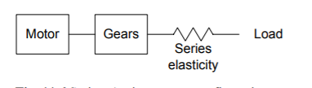
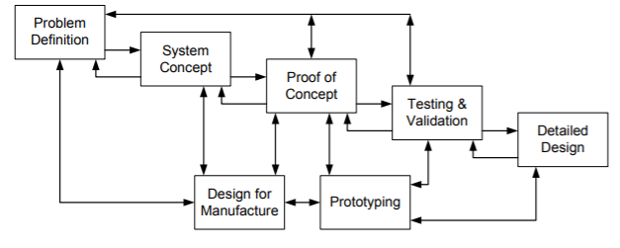
Current Prosthetics
Materials
Sensors
Typical sensor
Intelligent control
Transfemoral Prosthetics
Transtibial prosthetics
Research and development
System design and development
System development
Transfemoral prosthetics

Slide 8
Future Prosthetics
Development
Interaction
Independent signals
Electro-avtive polymers
Ionic polymer composites
Osseointegration

Slide 9
Conclusion
Overview
Human locomotion
Current prosthetics
Future Prosthetics

Slide 10
Questions

